Slide 1
Introduction to JUnit CS 4501 / 6501 Software Testing

Slide 2
Today’s Objective
Understand JUnit test classes
Understand anatomy of basic JUnit test methods
JUnit assertions and other features
Associated patterns for test programming

Slide 3
What is JUnit?
An open source Java testing framework (junit.org) used to write and run repeatable automated tests
JUnit is widely used in industry
A structure for writing test drivers
JUnit features include
Assertions to evaluate expected results
The ability to share common test data among tests
Test sets to easily organize and run tests
The ability to run tests from either a command line or a GUI
JUnit can be used as standalone Java programs (from the command line) or within an IDE such as Eclipse and NetBeans

Slide 4
JUnit Tests
JUnit can be used to an entire object, part of an object (a method or some interacting methods), and interaction between several objects
JUnit is primarily intended for unit and integration testing, not system testing
Each test is embedded into one test method
A test class contains one or more test methods
Test classes include
A collection of test methods
Method to set up the state before
Method to update the state after each test, and before and after all tests

Slide 5
Writing JUnit Tests
Download necessary jar files at junit.org
Use the methods of the org.junit.assert class
Refer to javadoc for a complete API
Each test method checks a condition (assertion) and reports to the test runner whether the test failed or succeeded
The test runner uses the result to report to the user
All of the methods return void

Slide 6
Common methods
assertTrue(boolean condition)
Assert that a condition is true
assertTrue(String message, boolean condition)
Assert that a condition is true
If the assertion is true, the string is ignored. If the assertion is not true, the string is sent to the test engineer.
assertEquals(Object expected, Object actual)
Assert that two objects are equal
fail(String message)
If a certain situation is expected when a certain section of code is reached, the string is sent to the test engineer.
Often used to test exceptional behavior

Slide 7
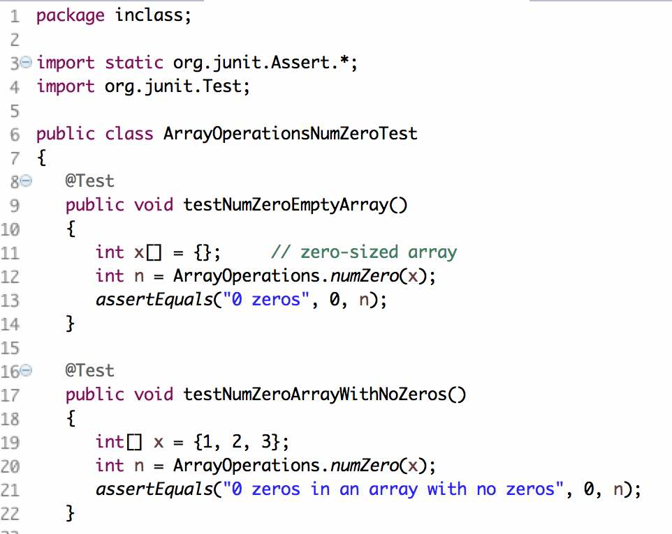
JUnit – Test Classes
Imports
Test class
Test
method
Another
test
method

Slide 8
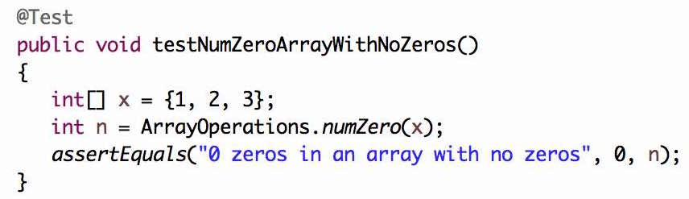
JUnit – Test Methods
1) Setup test case values
2) Execute program
under test
expected
3) Assert expected vs. actual test outputs
actual output

Slide 9
Let’s do some exercises

